Slide 1


Slide 2
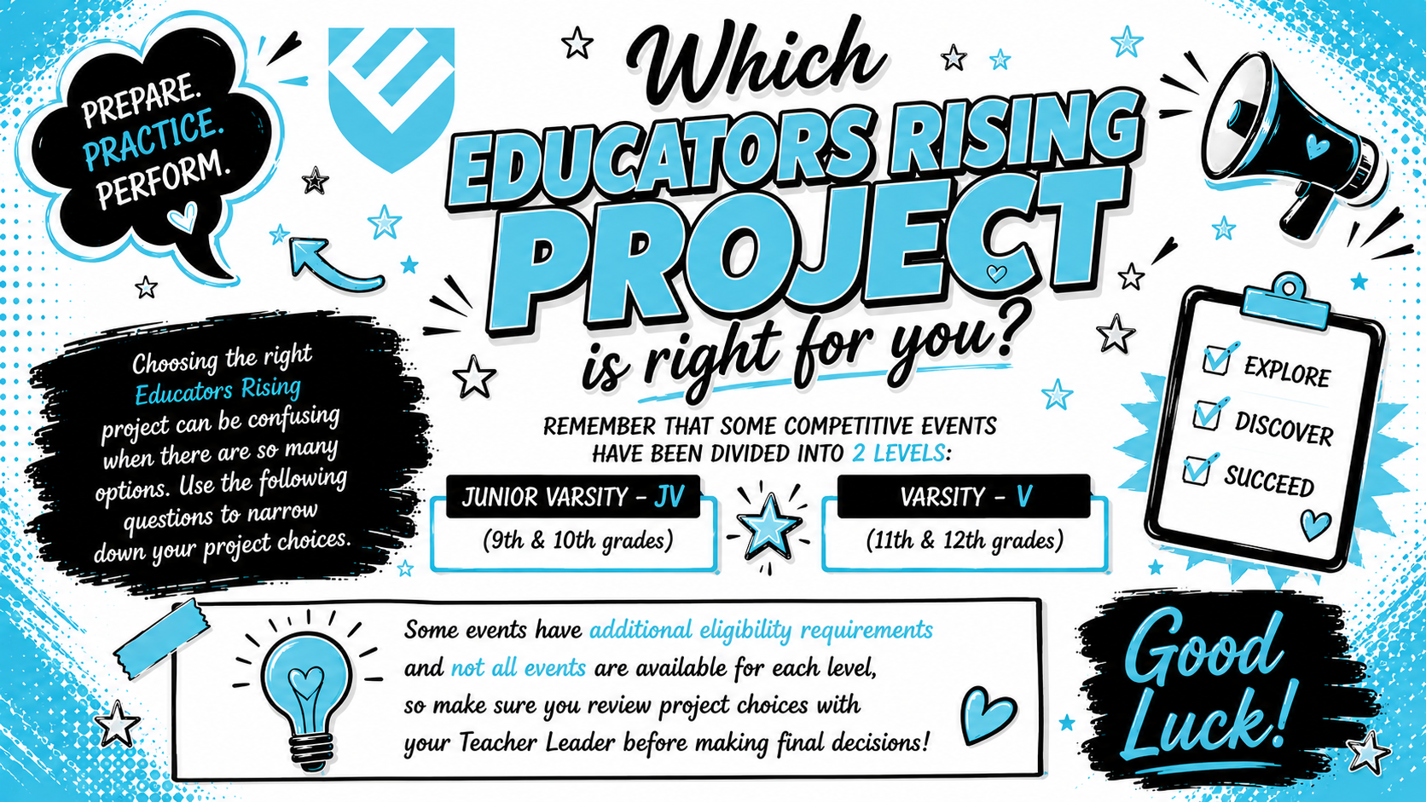

Slide 3


Teaching others new things
Learning about careers in the field of education
Researching ways to improve education
Debating an education topic
Planning and organizing activities for my school and community
Designing and creating learning activities for young children
Public Speaking - Using my voice to make a positive change
Improving myself or my Educators Rising chapter
Writing and illustrating stories for children
Service Learning - Participating in projects that help others and give you
Sharing the value of the teacher profession through digital media

Slide 4


You enjoy learning and helping others learn too!
The following events will help you refine your teaching skills!
Click on a competitive event below to learn more.
2026–2027 Update Notice: Official Educators Rising rubrics have not yet been released. Event pages and resources will be updated as soon as the official materials become available.
🏆 Lesson Planning & Delivery – Arts (JV/V Combined)
🏆 Lesson Planning & Delivery – Career & Technical Education (CTE) (JV/V Combined)
🏆 Lesson Planning & Delivery – Early Childhood Education (JV/V Combined)
🏆 Lesson Planning & Delivery – Humanities (JV/V Combined)
🏆 Lesson Planning & Delivery – Professional Development (JV/V Combined)
🏆 Lesson Planning & Delivery – STEM (JV/V Combined)
*Spanish not offered in Mississippi
What Is My Next Step?
Choose Another Interest

Slide 5
You enjoy learning about different careers within the Education and Training Career pathway.
The following events will give you an opportunity to learn first-hand what teachers, coaches, administrators and other support staff do!
Click on a competitive event below to learn more.
2026–2027 Update Notice: Official Educators Rising rubrics have not yet been released. Event pages and resources will be updated as soon as the official materials become available.
🏆 Exploring Education Administration Careers (Offered in JV and Varsity)
🏆 Exploring Non-Core Subject Teaching Careers (Offered in JV and Varsity)
🏆 Exploring Support Service Careers (Offered in JV and Varsity)
What Is My Next Step?
Choose Another Interest

Slide 6
You enjoy researching and presenting innovative ways teachers and schools can improve education for all students. The following events will give you an opportunity to learn and present your findings.
Click on a competitive event below to learn more.
2026–2027 Update Notice: Official Educators Rising rubrics have not yet been released. Event pages and resources will be updated as soon as the official materials become available.
🏆 Researching Learning Challenges (Offered in JV and Varsity)
🏆 Inside Our Schools Presentation (Offered in JV and Varsity)
*Spanish not offered in Mississippi
What Is My Next Step?
Choose Another Interest

Slide 7
You enjoy discussing education topics and looking at a situation from several different viewpoints. The following events will give you the chance to explore assigned education topics and
express your understanding of them.
Click on a competitive event below to learn more.
2026–2027 Update Notice: Official Educators Rising rubrics have not yet been released. Event pages and resources will be updated as soon as the official materials become available.
🏆Ethical Dilemma Competition (Offered in JV and Varsity)
🏆Public Speaking Competition (Offered in JV and Varsity)
What Is My Next Step?
Choose Another Interest

Slide 8
You enjoy planning and organizing activities for your school and community.
The following events will allow you to showcase what your Educators Rising chapter has done to
make your school and community better!
Click on a competitive event below to learn more.
2026–2027 Update Notice: Official Educators Rising rubrics have not yet been released. Event pages and resources will be updated as soon as the official materials become available.
🏆Project Visualize - Service Project (Offered in JV and Varsity)
What Is My Next Step?
Choose Another Interest

Slide 9
You enjoy designing and creating learning activities for young children.
The following events will allow you to showcase your creativity in the classroom and teach others creative ways to help children learn.
Click on a competitive event below to learn more.
2026–2027 Update Notice: Official Educators Rising rubrics have not yet been released. Event pages and resources will be updated as soon as the official materials become available.
🏆Interactive Bulletin Board Contest (Offered in JV and Varsity)
  Elementary
  Middle School / High School
🏆Teacher Created Materials Contest (Offered in JV and Varsity)
What Is My Next Step?
Choose Another Interest

Slide 10
You enjoy using your voice to make a positive change in your school and community.
The following events will allow you to add your voice to global efforts in education reform
and promoting teaching as a profession.
Click on a competitive event below to learn more.
2026–2027 Update Notice: Official Educators Rising rubrics have not yet been released. Event pages and resources will be updated as soon as the official materials become available.
🏆Public Speaking Competition (Offered in JV and Varsity)
🏆Educators Rising Moment Competition (Offered in JV and Varsity)
*Spanish not offered in Mississippi
🏆Creative Lecture Competition (Offered in JV and Varsity)
What Is My Next Step?
Choose Another Interest

Slide 11
You enjoy working on improving yourself and your Educators Rising chapter.
The following events will help you develop and demonstrate skills needed in a
achieving a career in the field of education.
Click on a competitive event below to learn more.
2026–2027 Update Notice: Official Educators Rising rubrics have not yet been released. Event pages and resources will be updated as soon as the official materials become available.
🏆 Job Interview Competition (Offered in JV and Varsity)
What Is My Next Step?
Choose Another Interest

Slide 12
You enjoy writing and illustrating stories for children. The following events will
allow you to showcase your talents in teaching children through literature.
Click on a competitive event below to learn more.
2026–2027 Update Notice: Official Educators Rising rubrics have not yet been released. Event pages and resources will be updated as soon as the official materials become available.
🏆 Children's Literature K-3 Competition (Offered in JV and Varsity)
🏆 Children's Literature Pre-k Competition (Offered in JV and Varsity)
🏆 Children's Literature K-3 Competition Spanish (Offered in JV and Varsity)
🏆 Children's Literature Pre-k Competition Spanish (Offered in JV and Varsity)
What Is My Next Step?
Choose Another Interest

Slide 13
You enjoy participating in projects that help others while giving you opportunities to learn.
The following event encourages inspired, proactive Educators Rising members
to make an impact in their communities through service learning.
Click on a competitive event below to learn more.
2026–2027 Update Notice: Official Educators Rising rubrics have not yet been released. Event pages and resources will be updated as soon as the official materials become available.
🏆 Educators Rising Leadership Award Competition (Varsity ONLY)
What Is My Next Step?
Choose Another Interest

Slide 14
You believe that the educator profession is an important career that needs to be valued and celebrated. The following event will give you the opportunity to create a video and live presentation that would appeal to anyone looking for smart ways to recruit new teachers and to the teacher candidates themselves.
Click on a competitive event below to learn more.
2026–2027 Update Notice: Official Educators Rising rubrics have not yet been released. Event pages and resources will be updated as soon as the official materials become available.
🏆 Public Service Announcement—Teacher Recruitment (Offered in JV and Varsity)
What Is My Next Step?
Choose Another Interest

Slide 15

Choose Another Interest

