Slide 1

Join the Future of Education
Inspire. Lead. Teach.

Slide 2
What is Educators Rising?
A national career and technical student organization (CTSO)
For students interested in education-related careers
Offers real-world teaching experiences, leadership, and training

Slide 3
Goals of Educators Rising
To recruit qualified youth to become teachers, to help eliminate the shortages within the profession and to strengthen requirements for teacher candidates.
To provide students with experiences in high school that will keep them committed to becoming teachers throughout their college career.
To strengthen the image of the teaching profession through providing information and counseling to students.
To encourage personal growth of future educators through participation in region and state meetings, organizations and workshops.
To increase student involvement and foster pride in their school and community while contributing to the educational experience.

Slide 4
Why Join Educators Rising?
Learn what it’s like to be a teacher
Build leadership and communication skills
Attend conferences, compete, and network
Mentorship and real classroom experience
Give back by Participating in community service projects

Slide 5
Why Join Educators Rising?
Looks good on transcripts
Seniors receive a graduation cord if the requirements are met (Set by Advisor)
Scholarship opportunities
Travel and networking opportunities

Slide 6
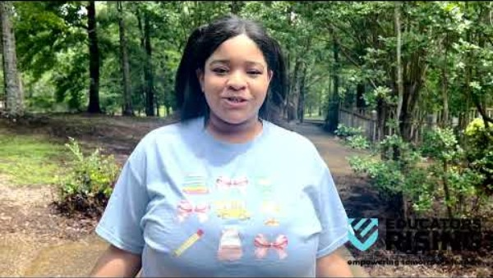

Slide 7
Who Can Join?
Open to any student interested in a future in education
high school students in grades 9-12
  Junior Varsity: 9th and 10th grade
  Varsity: 11th and 12th grade

Slide 8
What Do We Do?
Attend state and national conferences
Compete in education-focused events
Volunteer and serve your community
Visit classrooms and meet professionals

Slide 9
Competitions and Conferences
Compete in Lesson Planning, Public Speaking, and more
Travel to state and national events
Build your resume and college applications

Slide 10
Competitive Events
Children’s Literature—k-3
Children’s Literature—k-3- Spanish
Children’s Literature—Pre-k
Children’s Literature—Pre-k- Spanish
Creative Lecture—Ted Talk
Educators Rising Leadership Award (Varsity ONLy)
Educators Rising Moment
Educators Rising Moment—Spanish
Ethical Dilemma
Exploring Education Administration Careers
Exploring Non-Core Subject Teaching Careers
Exploring Support Services Careers
Inside our schools
Inside our schools—Spanish
Job Interview
Lesson Planning and Delivery—Arts
Lesson Planning and Delivery—CTE
Lesson Planning and Delivery—Humanities
Lesson Planning and Delivery—Spanish
Lesson Planning and Delivery—Stem
Outstanding chapter
Public service announcement—teacher recruitment
Public Speaking

Slide 11
Competitive Events
Researching learning challenges
interactive bulletin board—elementary
Interactive bulletin board—middle/High School
Project visualize
Teacher created materials
Special NOTES:
All events are offered for JV and Varsity except:
  Educators Rising Leadership Award
  Outstanding chapter
All Spanish events will be totally in Spanish.
Each school may enter 2 Competitors/teams in each event except the following events:
  Varsity Children’s Literature—k-3
  Varsity Children’s Literature—Pre-K
  Varsity Teacher Created Materials
  JV Interactive Bulletin Board (Both)
  Varsity Interactive Bulletin Board (Both)

Slide 12


Conferences
Fall Leadership Conference
State Leadership Conference

Slide 13
Conference Dress Code
Fall Leadership Conference
State Leadership Conference
School or chapter t-shirts
  Shirts should be long enough to cover the midriff.
Khaki or Black pants
  No jeans and no holes in pants
During the conference students are allowed to wear:
  School/Chapter/State Conference T-shirt
  Khaki or Black Pants
    No holes or rips
    No jeans
Should be in professional dress attire.

Slide 14

Conferences
2025-2026 Community Service Project
Teddy Bear Drive Guidelines
📌 Purpose
To collect new teddy bears for donation to children at Batson Children's Hospital to provide comfort and support during their hospital stay.
✅ Donation Guidelines
Teddy bears must be brand new
  Due to hospital policies, used or pre-owned items cannot be accepted.
Maximum size: 20 inches tall
  Bears should be small enough to be easily stored and hugged by young children.
No sound chips, moving parts, or electronics
  Keep it simple—soft, plush, and huggable only.
No themed bears with potentially sensitive designs
  Avoid bears with scary, violent, or controversial themes.
  Neutral or cheerful designs are best.
Tags should be left on if possible
  Shows the item is new and unused.
📦 Collection Instructions
Bears should be brought to the conference registration area.
Chapters are responsible for keeping count of their total donations.
If you have a large quantity, label your box or bag with your school's name.
🏆 Community Service Award
The chapter that donates the most teddy bears will be recognized with the
“2026 Community Service Award” at the conference.

Slide 15

State Conference Opportunities
National Anthem Auditions
Submission Details:
• Record a video of the student singing the National Anthem (solo, a cappella).
• Upload the video to YouTube (unlisted or public).
• Submit the video link via the Google Form by Tuesday, January 12, 2026, at 3:00 p.m.

Slide 16

State Conference Opportunities
Mississippi Honor Society
Eligibility Requirements:
To be considered for the Honor Society, students must:
  Be a high school junior or senior
  Have a minimum cumulative GPA of 3.5 on a 4.0 scale (including grades from the first semester of the current academic year)
  Be an Active-level (dues-paying) member of Educators Rising
Recognition Includes: Students who are accepted into the Honor Society will receive:
  A personalized certificate of recognition
  A Mississippi Educators Rising Honor Society lapel pin to wear on their graduation stole

Slide 17










State Conference Opportunities
Mississippi Signing event
Who Can Participate?
High school seniors who plan to enroll in a college or university and major in education.
What Will Students Receive?
An Educators Rising Certificate of Recognition
A College Swag Bag
The opportunity to participate in a special signing ceremony on stage at the conference

Slide 18

State Conference Opportunities
Mississippi State Officer
State Officers are expected to:
Communicate regularly and respond promptly to all inquiries for information.
Check GroupMe daily.
Attend all state officer meetings and functions from start to finish.
Participate in conference calls with other state officers as needed.
As needed, preside over state officer meetings ensuring that the agenda is followed.
Help plan state conferences.
Work to recruit new chapters and new members.
Support teachers in their efforts to implement Educators Rising Mississippi.
Perform other duties as assigned.
Maintain a “90 or above” average in all courses.

Slide 19

State Conference Opportunities
Mississippi State Officer
State Officers are expected to:
Communicate regularly and respond promptly to all inquiries for information.
Check GroupMe daily.
Attend all state officer meetings and functions from start to finish.
Participate in conference calls with other state officers as needed.
As needed, preside over state officer meetings ensuring that the agenda is followed.
Help plan state conferences.
Work to recruit new chapters and new members.
Support teachers in their efforts to implement Educators Rising Mississippi.
Perform other duties as assigned.
Maintain a “90 or above” average in all courses.

Slide 20

Game Room

Slide 21
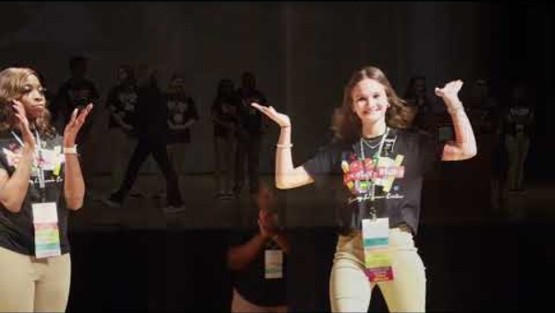

Slide 22
Benefits of Membership
Explore a meaningful, impactful career
Receive scholarships and mentorship
Join a community that supports your dreams

Slide 23
What Students Say
“I joined Educators Rising because I want to make a difference.”
“This helped me realize I really want to become a teacher!”
“I like meeting new people from across the United states!”
“I like competing—Cause I’m competitive!”

Slide 24
How to Join
Talk to your local chapter advisor
Follow your chapter on social media
Attend an interest meeting
Get involved—your future starts here!

Slide 25
You Belong Here
Discover your passion. Build your future.
The classroom is calling!

Slide 26
Let’s Chat!
Ask ME anything!
I’D love to help you start your Educators Rising journey.

